Slide 1
STOCK MARKET ANALYSIS
-Keshav Kant Mishra
19BCS1887

Slide 2


Slide 3


Slide 4
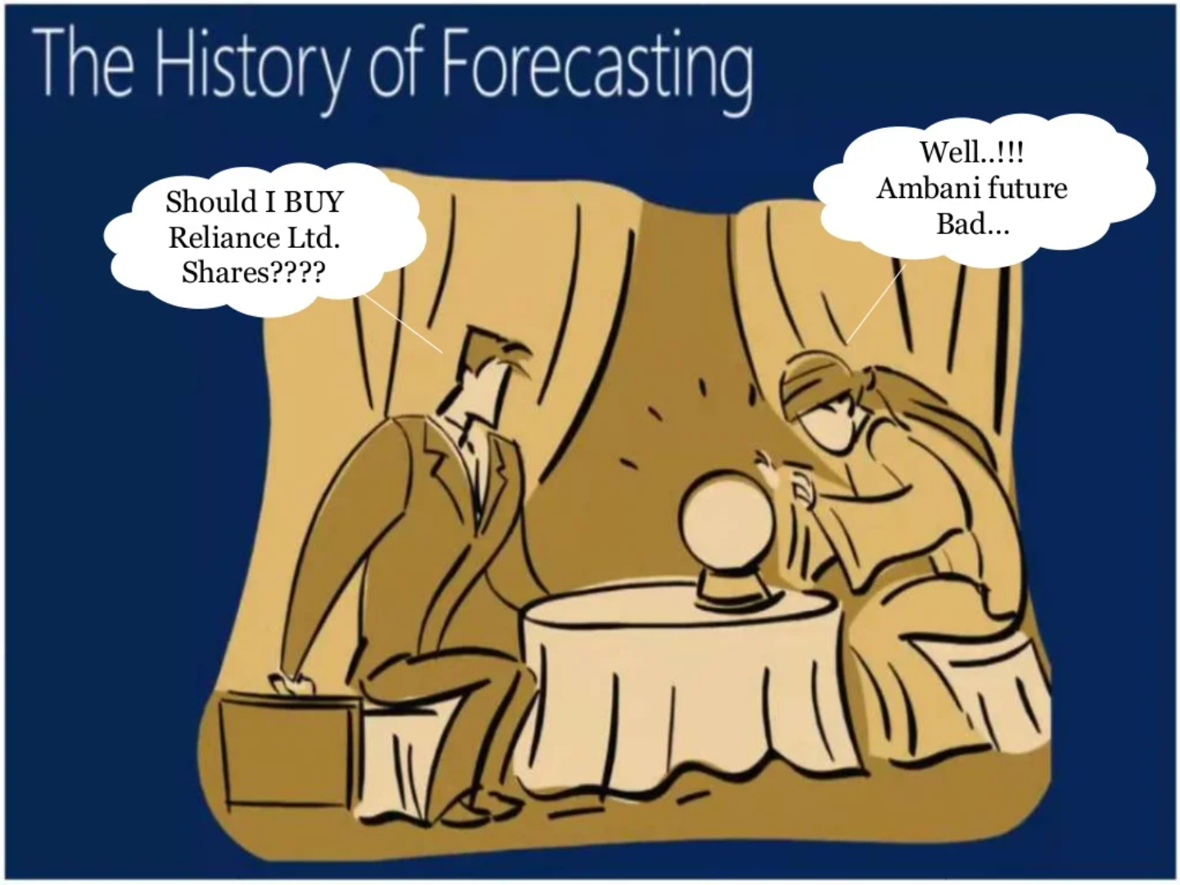

Slide 5


Slide 6
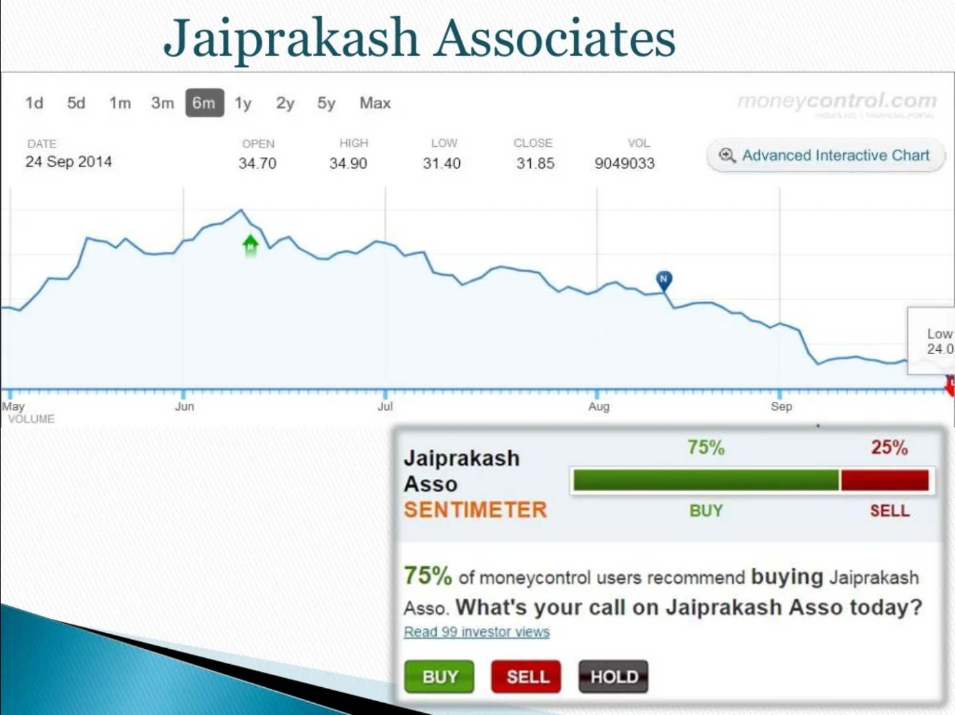

Slide 7
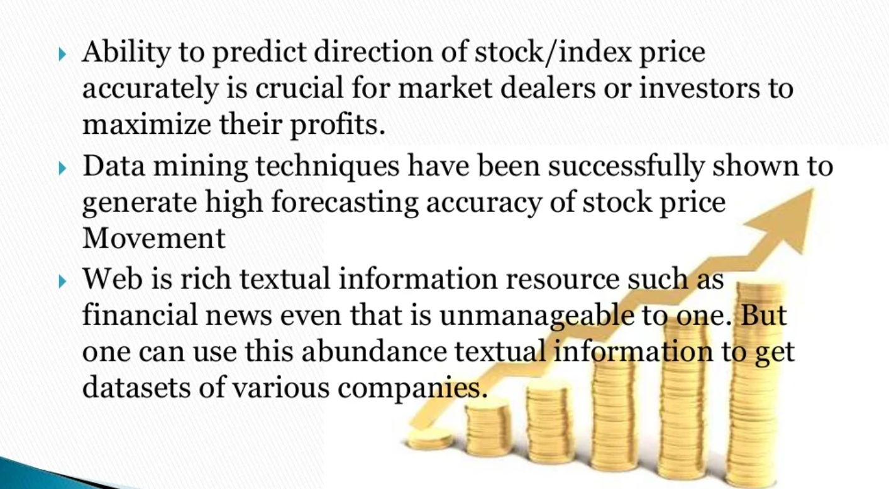
INTRODUCTION:

Slide 8
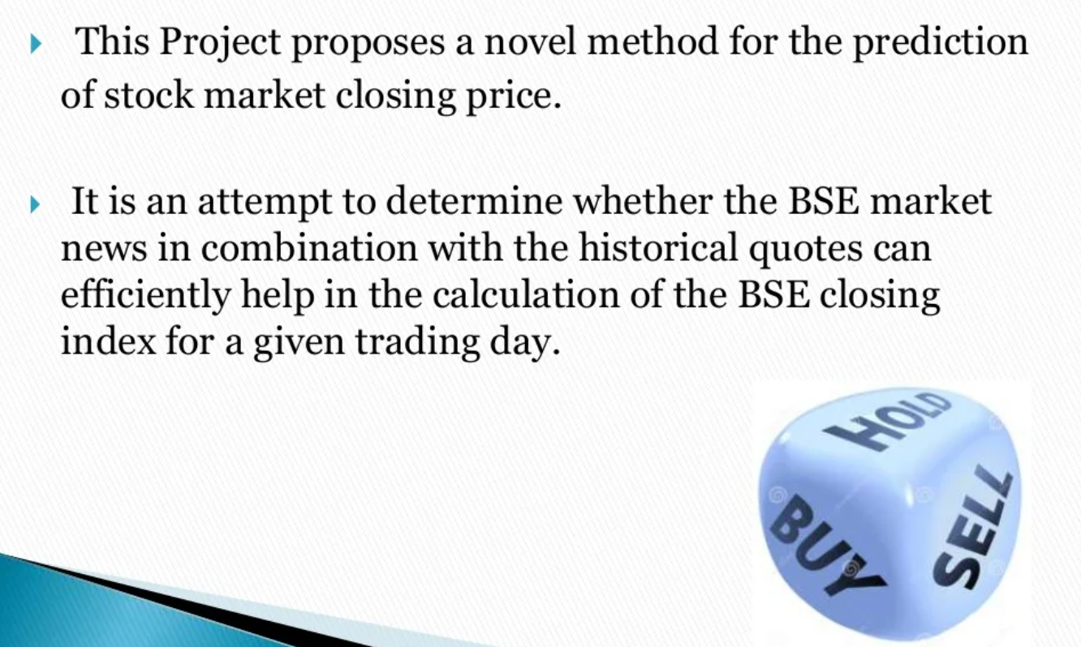
GOALS:

Slide 9
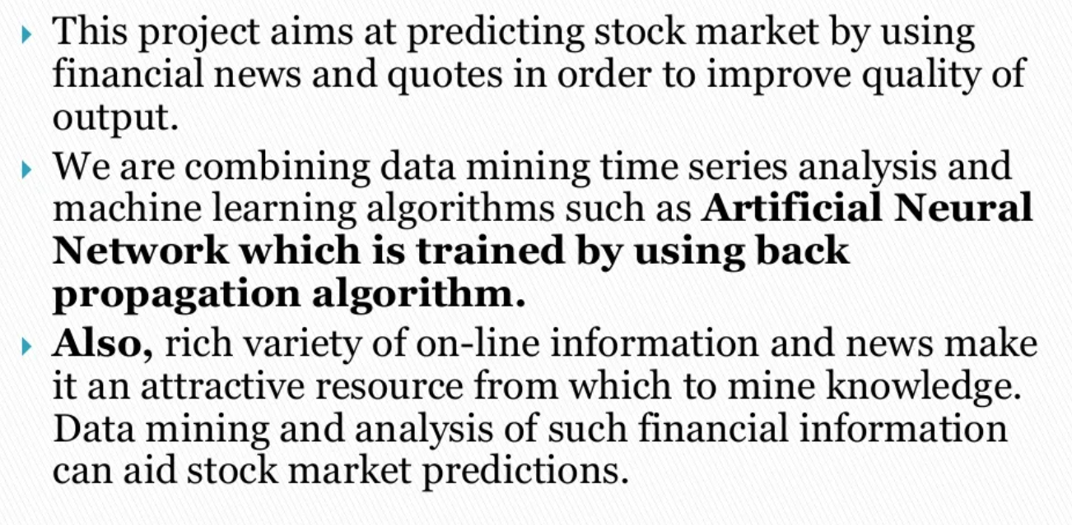
ARCHITECTURE OF APPLICATION:

Slide 10
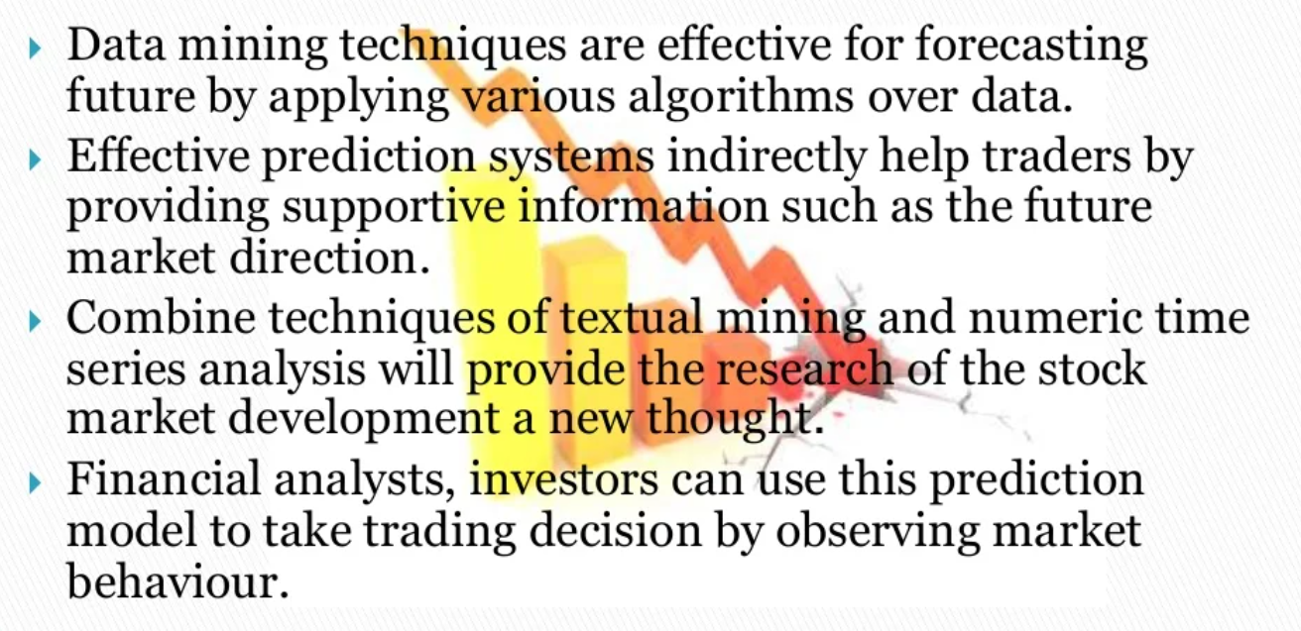
BENEFITS/ NOVELITY OF THE APPLICATION:

Slide 11
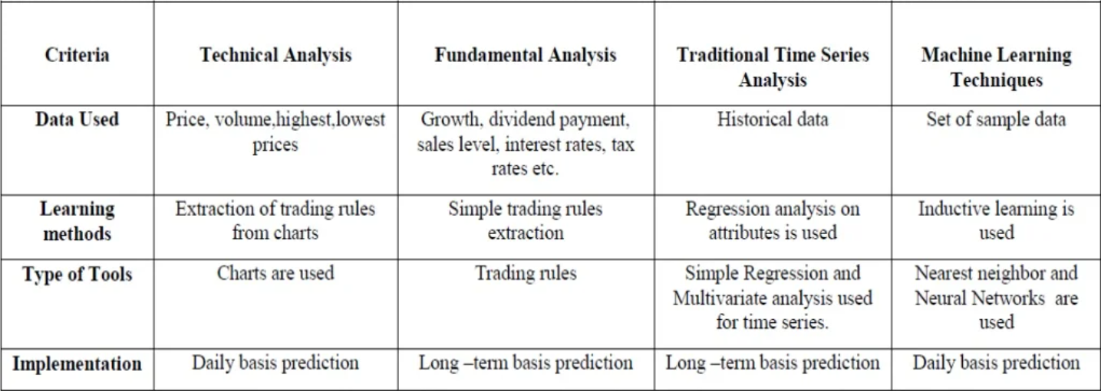
COMPARITIVE STUDY OF TECHNIQUES

Slide 12
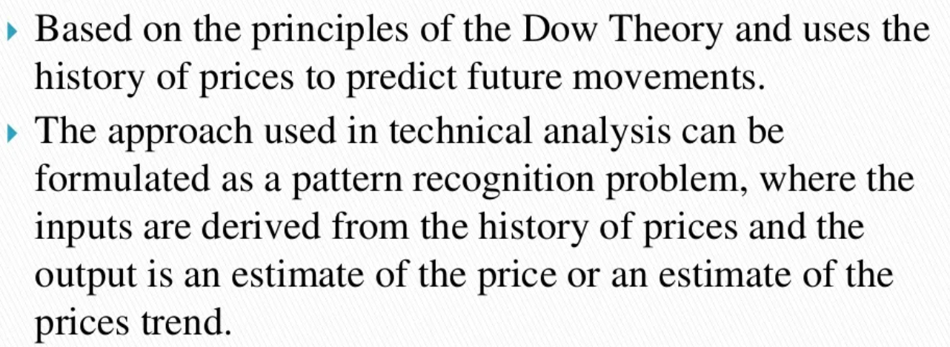
TECHNICAL ANALYSIS:

Slide 13
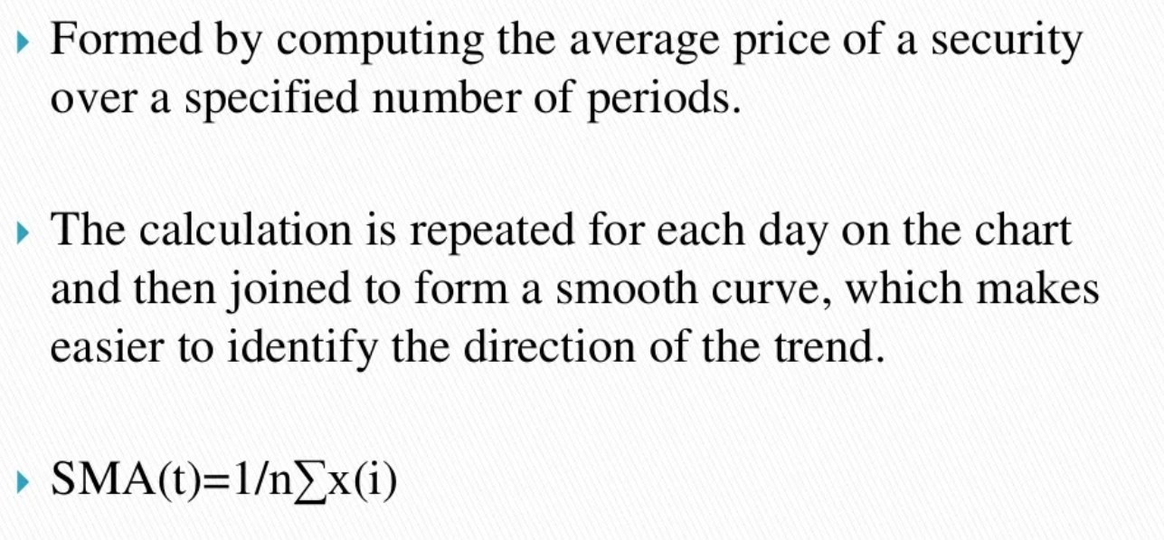
SIMPLE MOVING AVERAGE:

Slide 14
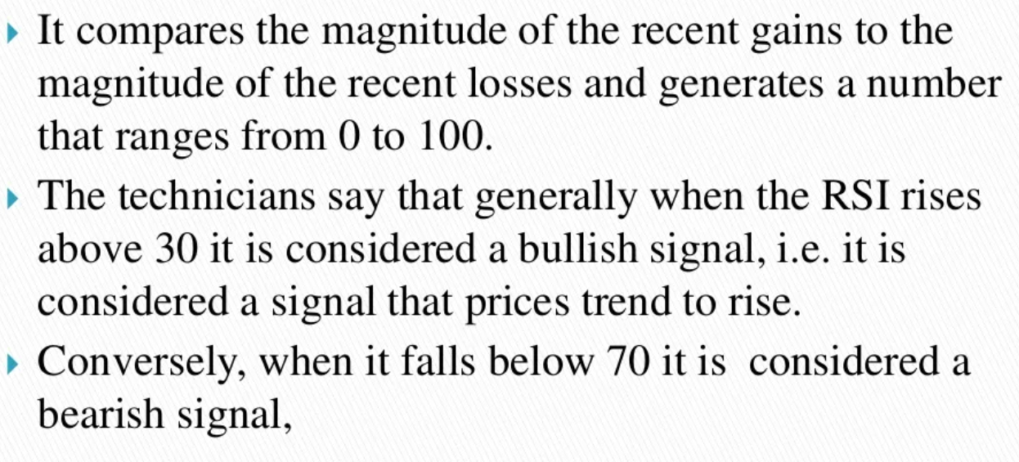
RELATIVE STRENGTH INDEX:

Slide 15
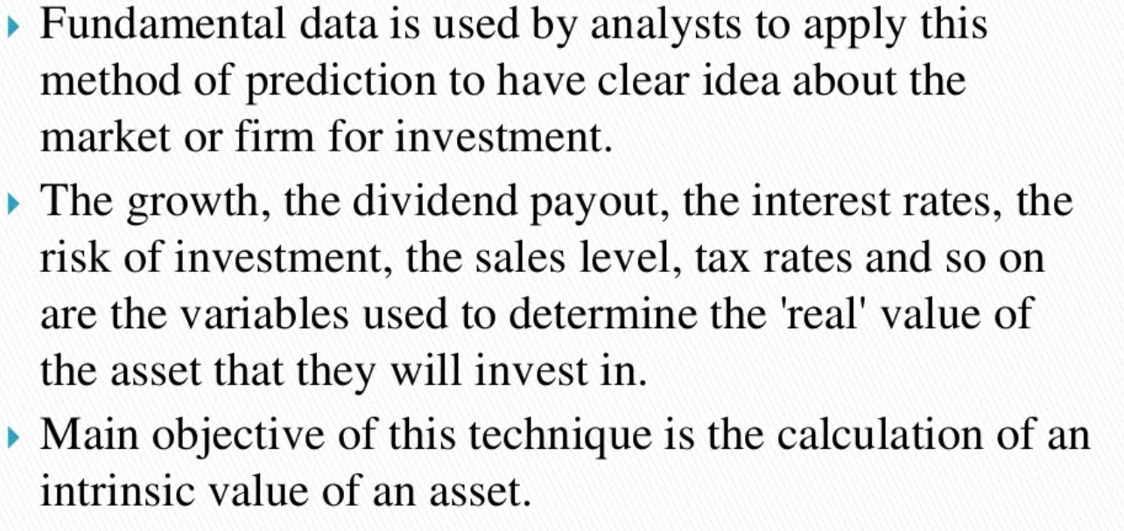
FUNDAMENTAL ANALYSIS TECHNIQUES:

Slide 16

DATASET:

Slide 17
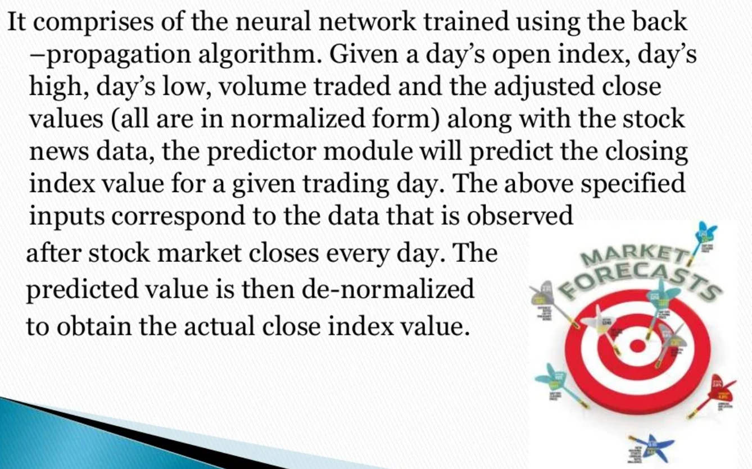
PREDICTION:

Slide 18
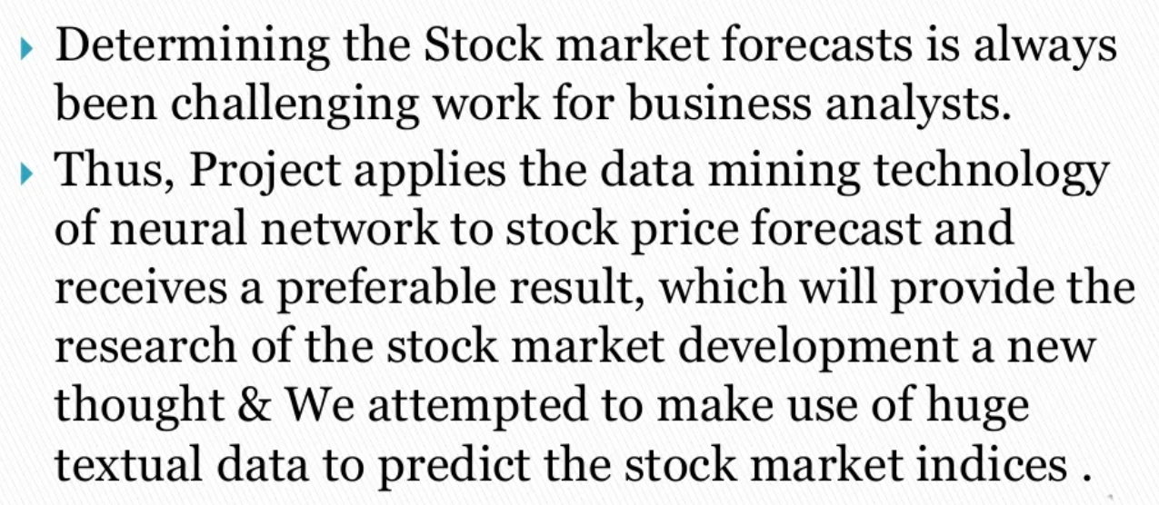
CONCLUSION:

Slide 19
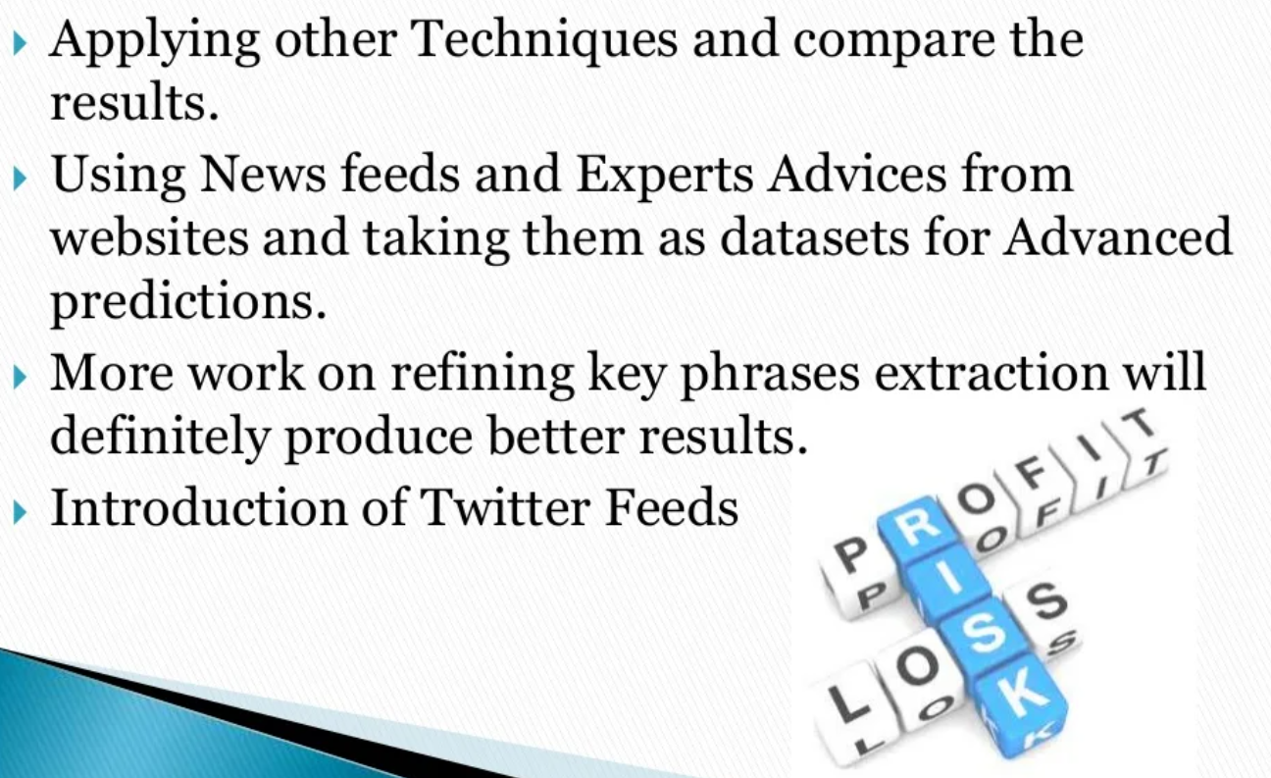
FUTURE STEPS:

